Slide 1
FINANCIAL MANAGEMENT ASSIGNMENT
AMARTYA SOM

Slide 2
OBJECTIVE
The objective of this project is to calculate Tech Mahindra Ltd.'s cost of equity capital using both the top-down and bottom-up approaches, as well as its cost of debt and Weighted Average Cost of Capital (WACC).
For the top-down approach, we rely on market data and models like the Capital Asset Pricing Model (CAPM) to estimate the cost of equity based on systematic risks.
In the bottom-up approach, we calculate an industry-specific 𝛃_{equity}, using comparable companies from the IT services sector, including Infosys Ltd., Wipro Ltd., and HCL Technologies Ltd., to derive an adjusted 𝛃_{equity} for Tech Mahindra. This approach considers Tech Mahindra’s unique risk profile by weighting it according to these peer firms, providing a more tailored cost of equity.
The project ultimately aims to estimate the WACC, integrating both equity and debt costs to determine the firm's blended capital cost, crucial for making investment and financing decisions.

Slide 3
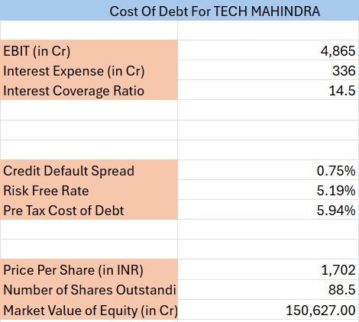
COST OF DEBT
The cost of debt is the effective rate that a company pays on its borrowed funds. It represents the interest expense a company incurs on its debt.
TECH MAHINDRA falls into the category of high Market Capitalization with a Credit Rating of AAA (as per the Credit Default Spread), the corresponding Spread Value was taken for the Cost of Debt calculation from -(https://pages.stern.nyu.edu/~adamodar/New_Home_Page/valquestions/syntrating.htm).
Cost of debt = credit default spread + risk free rate

Slide 4


TOP-DOWN APPROACH
This presentation outlines the process of calculating the cost of equity capital for Tech Mahindra Ltd. using a top-down approach, based on historical data and CAPM. The steps include:
We obtained historical monthly adjusted closing prices for Tech Mahindra Ltd. over 4 years(Jan 2020 - Jan 2024) from Yahoo Finance, and calculated monthly returns using the formula ln(Pt/Pt-1). For market comparison we gathered historical monthly prices for a relevant market index (i.e., NIFTY 50) to calculate corresponding monthly returns. Then we performed a regression analysis, using Tech Mahindra’s monthly returns as the dependent- variable and the market index returns as the independent variable. The slope of the regression line gives us the company’s levered beta, which we got as 𝛃 = 0.941554311.
Using the CAPM formula, we calculated the cost of equity as: Cost of Equity = (Risk-Free Rate) + (β×(Market Return - Risk-Free Rate)).The cost of equity was calculated to be 16.59%.
The cost of debt = 5.94%, tax rate = 27% and the debt to equity ratio = 0.08.
Risk free rate has been taken as ytm of 91-day T-bill:
The final formula for WACC used is:

Slide 5
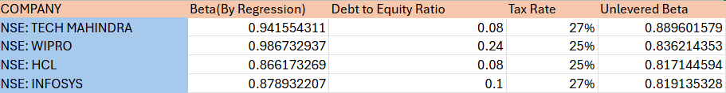
BOTTOM-UP APPROACH
This project presentation outlines the calculation of Tech Mahindra Ltd.'s cost of equity, cost of debt, and Weighted Average Cost of Capital (WACC) using a bottom-up approach. First, we select comparable companies within the same industry, that is Infosys, Wipro, and HCL Technologies in our case , to analyze typical beta and leverage metrics. Using the regression approach and Python code, we calculate each firm’s equity beta (𝛃_{equity}), reflecting sensitivity to market fluctuations.
To isolate intrinsic business risk, we unlever the betas of each company and calculate an average unlevered beta = 0.824164 , representing an industry benchmark. For Tech Mahindra, we relever this beta based on its unique debt-to-equity ratio = 0.08 and get 𝛃 = 0.87229598. For the cost of debt = 5.94%, we estimate a credit rating using the EBIT/Interest Expense ratio and apply a credit default spread from NYU Stern’s synthetic ratings, adding this spread to the risk-free rate.

Slide 6
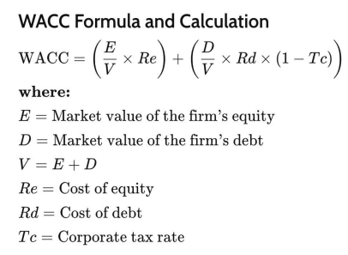
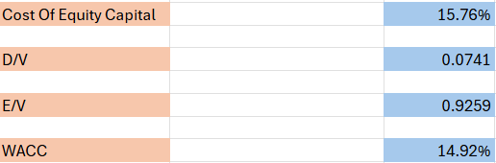
BOTTOM-UP APPROACH
Using the CAPM formula, we calculated the cost of equity as:
Cost of Equity = (Risk-Free Rate) + (β×(Market Return - Risk-Free Rate)) = .5.18568% + (0.87229598×(0.173116252-0.0518568))
The cost of equity was calculated to be 15.76%
Finally, we determine Tech Mahindra’s market value of equity and calculate WACC by weighting the cost of debt and equity according to its capital structure, providing a blended financing cost essential for investment evaluation.

Slide 7
REFERENCES
https://finance.yahoo.com/quote/TECHM.NS/
https://finance.yahoo.com/quote/WIPRO.NS/
https://finance.yahoo.com/quote/INFY/
https://finance.yahoo.com/quote/HCLTECH.NS/
http://www.epwrfits.in/TreeViewSecurity.aspx
http://pages.stern.nyu.edu/~adamodar/New_Home_Page/valquestions/syntrating.htm
THANK YOU

